Slide 1
Enhancing copies in the Core of Relational Databases
September 23rd, 2022

Slide 2
01 – Previous meeting wrap up
02 – Task completion
03 – Current status
04 – Next steps

Slide 3
01
Previous meeting wrap up

Slide 4
Previous meeting comments
Custom loss function and train step functions. Regularization term.
Simple UCI databases.

Slide 5
03
Current status

Slide 6
Current Status
01
Generalization of the regularization term. Results with toy problems
02
First steps into Incremental Learning

Slide 7
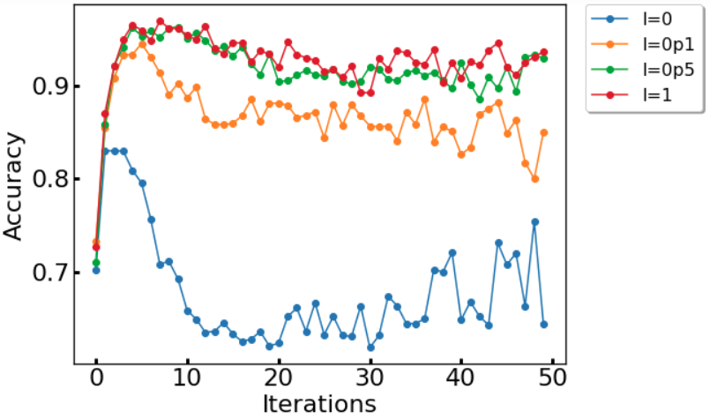
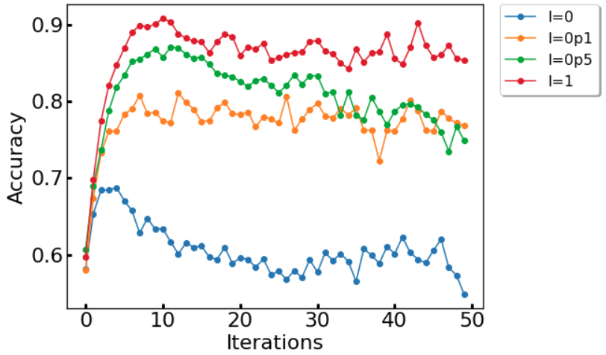
Generalization of the regularization term:
results with toy problems
Spirals database
N = 150
N = 75

Slide 8
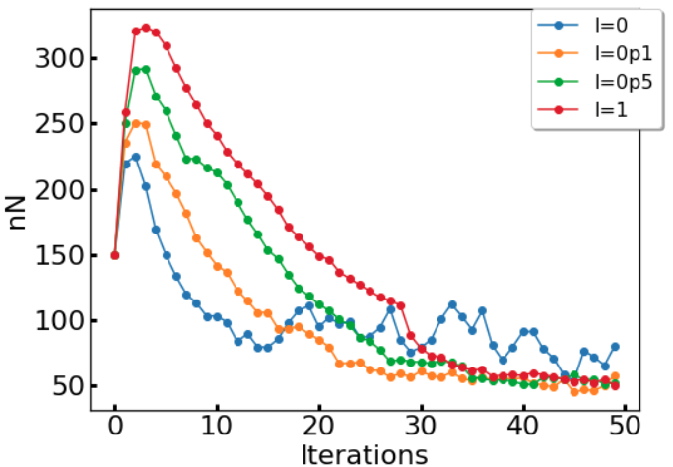
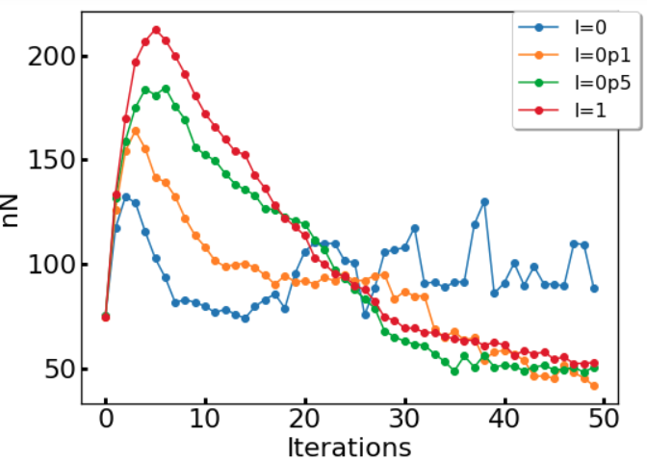
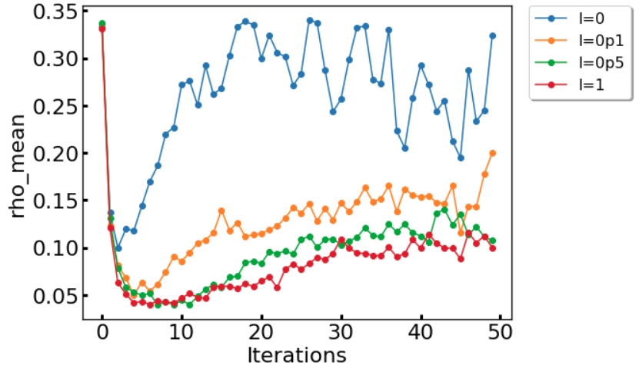
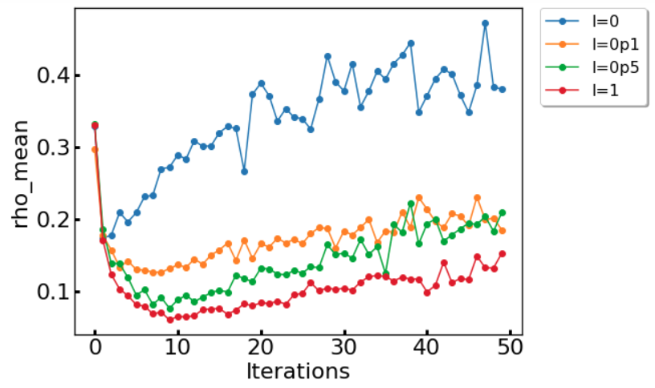
N = 150
N = 75

Slide 9
Current Status
01
Generalization of the regularization term. Results with toy problems
02
First steps into Incremental Learning

Slide 10
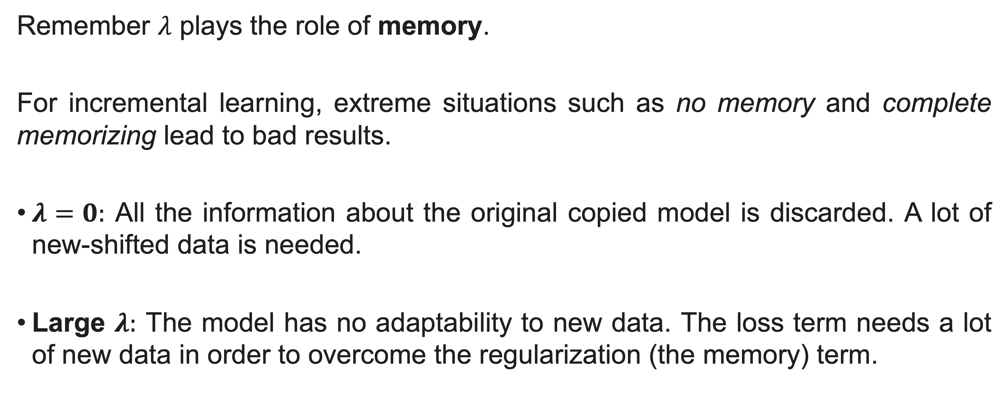
Incremental Learning
→ Understood as a shift in original data
Remember $λ$ plays the role of memory.
For incremental learning, extreme situations such as no memory and complete memorizing lead to bad results.
$λ=0:$ All the information about the original copied model is discarded. A lot of new-shifted data is needed.
Large $λ:$ The model has no adaptability to new data. The loss term needs a lot of new data in order to overcome the regularization (the memory) term.

Slide 11
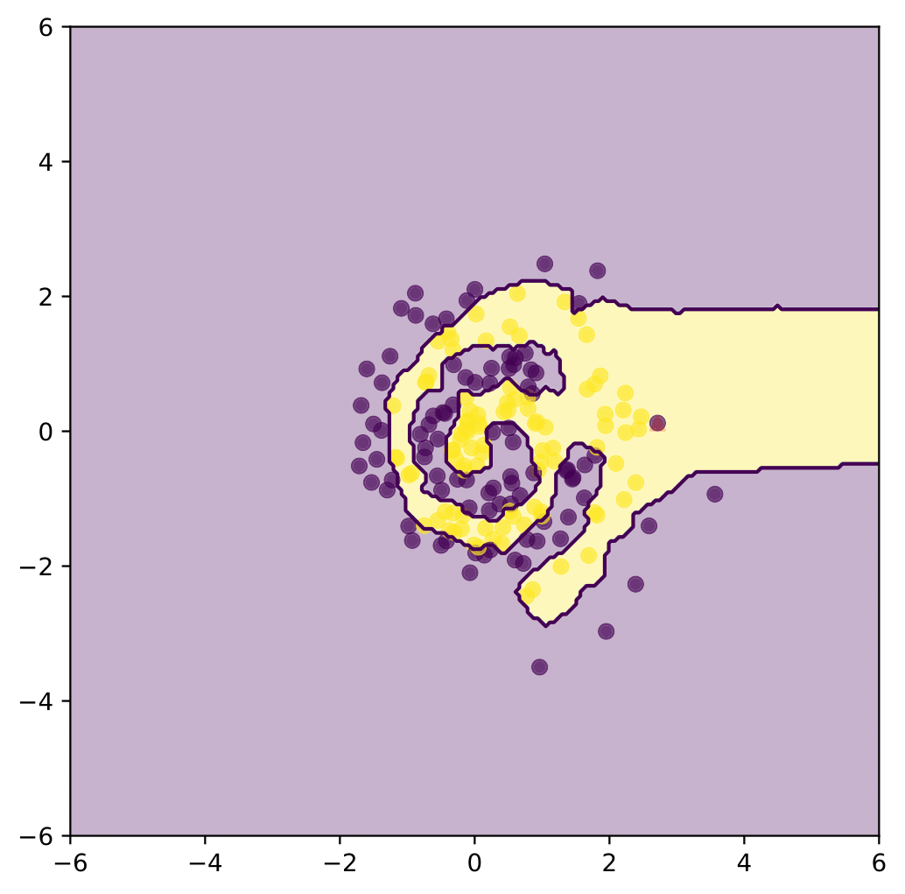
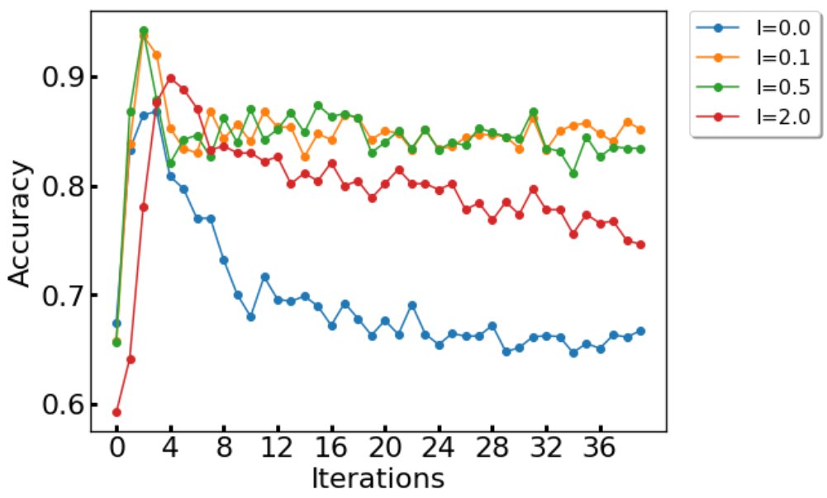
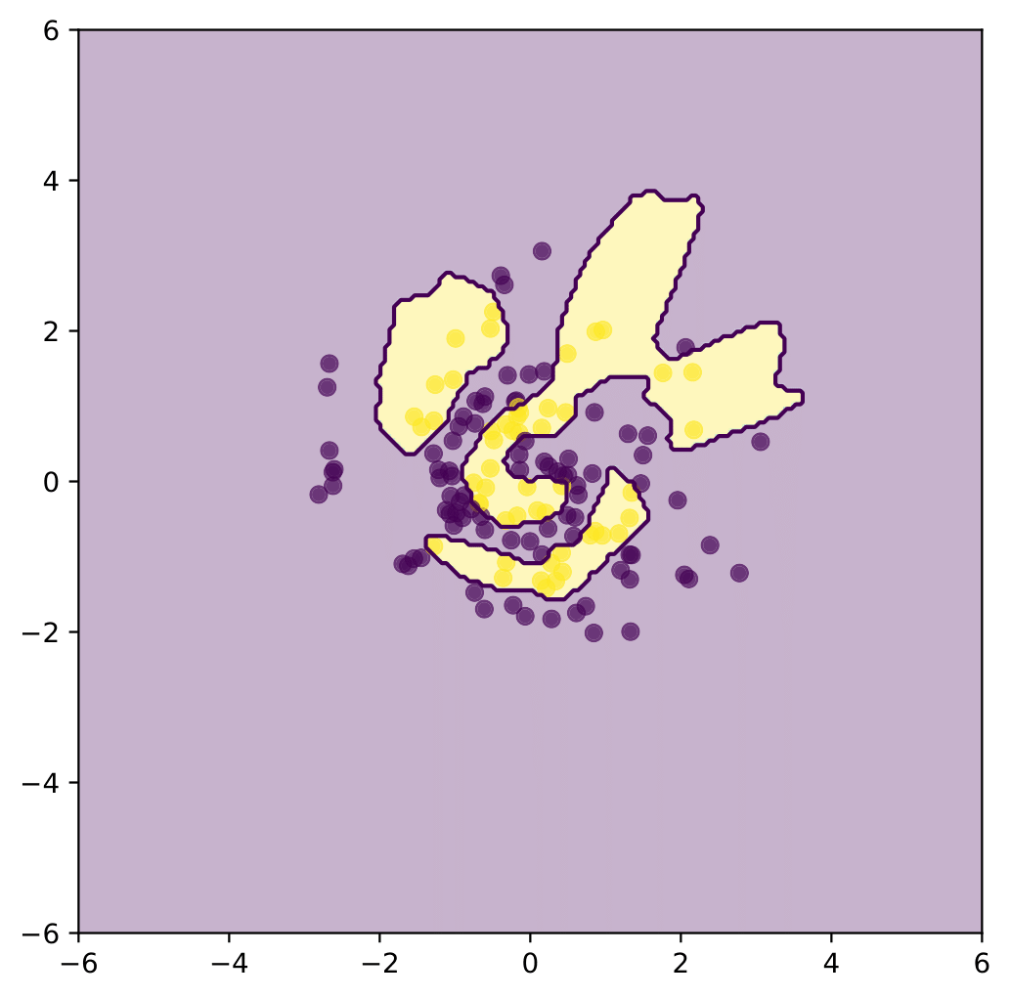
Linear shift (l=0.5)
Incremental Learning
Spirals database
Linear shift
N = 150
Rotation (l=0.5)

Slide 12
04
Next Steps

Slide 13
Next Steps
01
Generalization of the incremental learning process. UCI databases
02
High dimension databases (we have created a new sampling function not tested)
03
Continue with the incremental learning framework

